Slide 1
CS 2600 Computer Networks I Dr. Sayeed Sajal Lecture 12 Noise and the Shannon-Hartley Theorem

Slide 2
Cable Modems
Uses the cable TV (CATV) network
Runs within one or more standard 6MHz analog cable TV channels
Up to ~1.2Gbps down/200Mbps up (U.S.), but shared by everyone in your neighborhood – works like a big non-switched Ethernet
Cable modem demodulates analog and converts Internet traffic to Ethernet or WiFi using QAM
Most carriers use an interface standard called DOCSIS 3.1
Carriers may also provide voice (phone) service via cable (and TV, of course)
Not as popular in most other nations
Available in many parts of Utah Valley through Comcast’s Xfinity service

Slide 3
Municipal Owned Fiber Optic Networks (1 of 2)
iProvo/Google Fiber
As iProvo, was at one time the largest city-owned broadband network in the U.S.
Provided Internet, TV and voice over fiber (the “triple play”)
In 2013, Provo sold iProvo to Google for $1, making Provo the third Google Fiber city
Google Fiber services include Gigabit + TV , Gigabit Internet, and free basic Internet

Slide 4
Municipal Owned Fiber Networks (2 of 2)
UTOPIA (www.utopianet.org)
Consortium of 11 Utah cities
Provides Internet, TV and voice over fiber, at 25-100Mbps or better
UTOPIA just owns the fiber and switches
Various providers compete for customers (Veracity, Fibernet, Xmission)
Utopia is also losing money, but looking better recently
Orem’s share of $475M debt is approx. $100M, 40% of Orem homes have access
Spanish Fork Community Network is one municipal network that is financially viable (historically earning the city $200,000 – $400,000 per year)
Cable-based download rates 12Mpbs to 111Mbps
$35 to $95 per month for Internet-only service, TV and voice also available

Slide 5
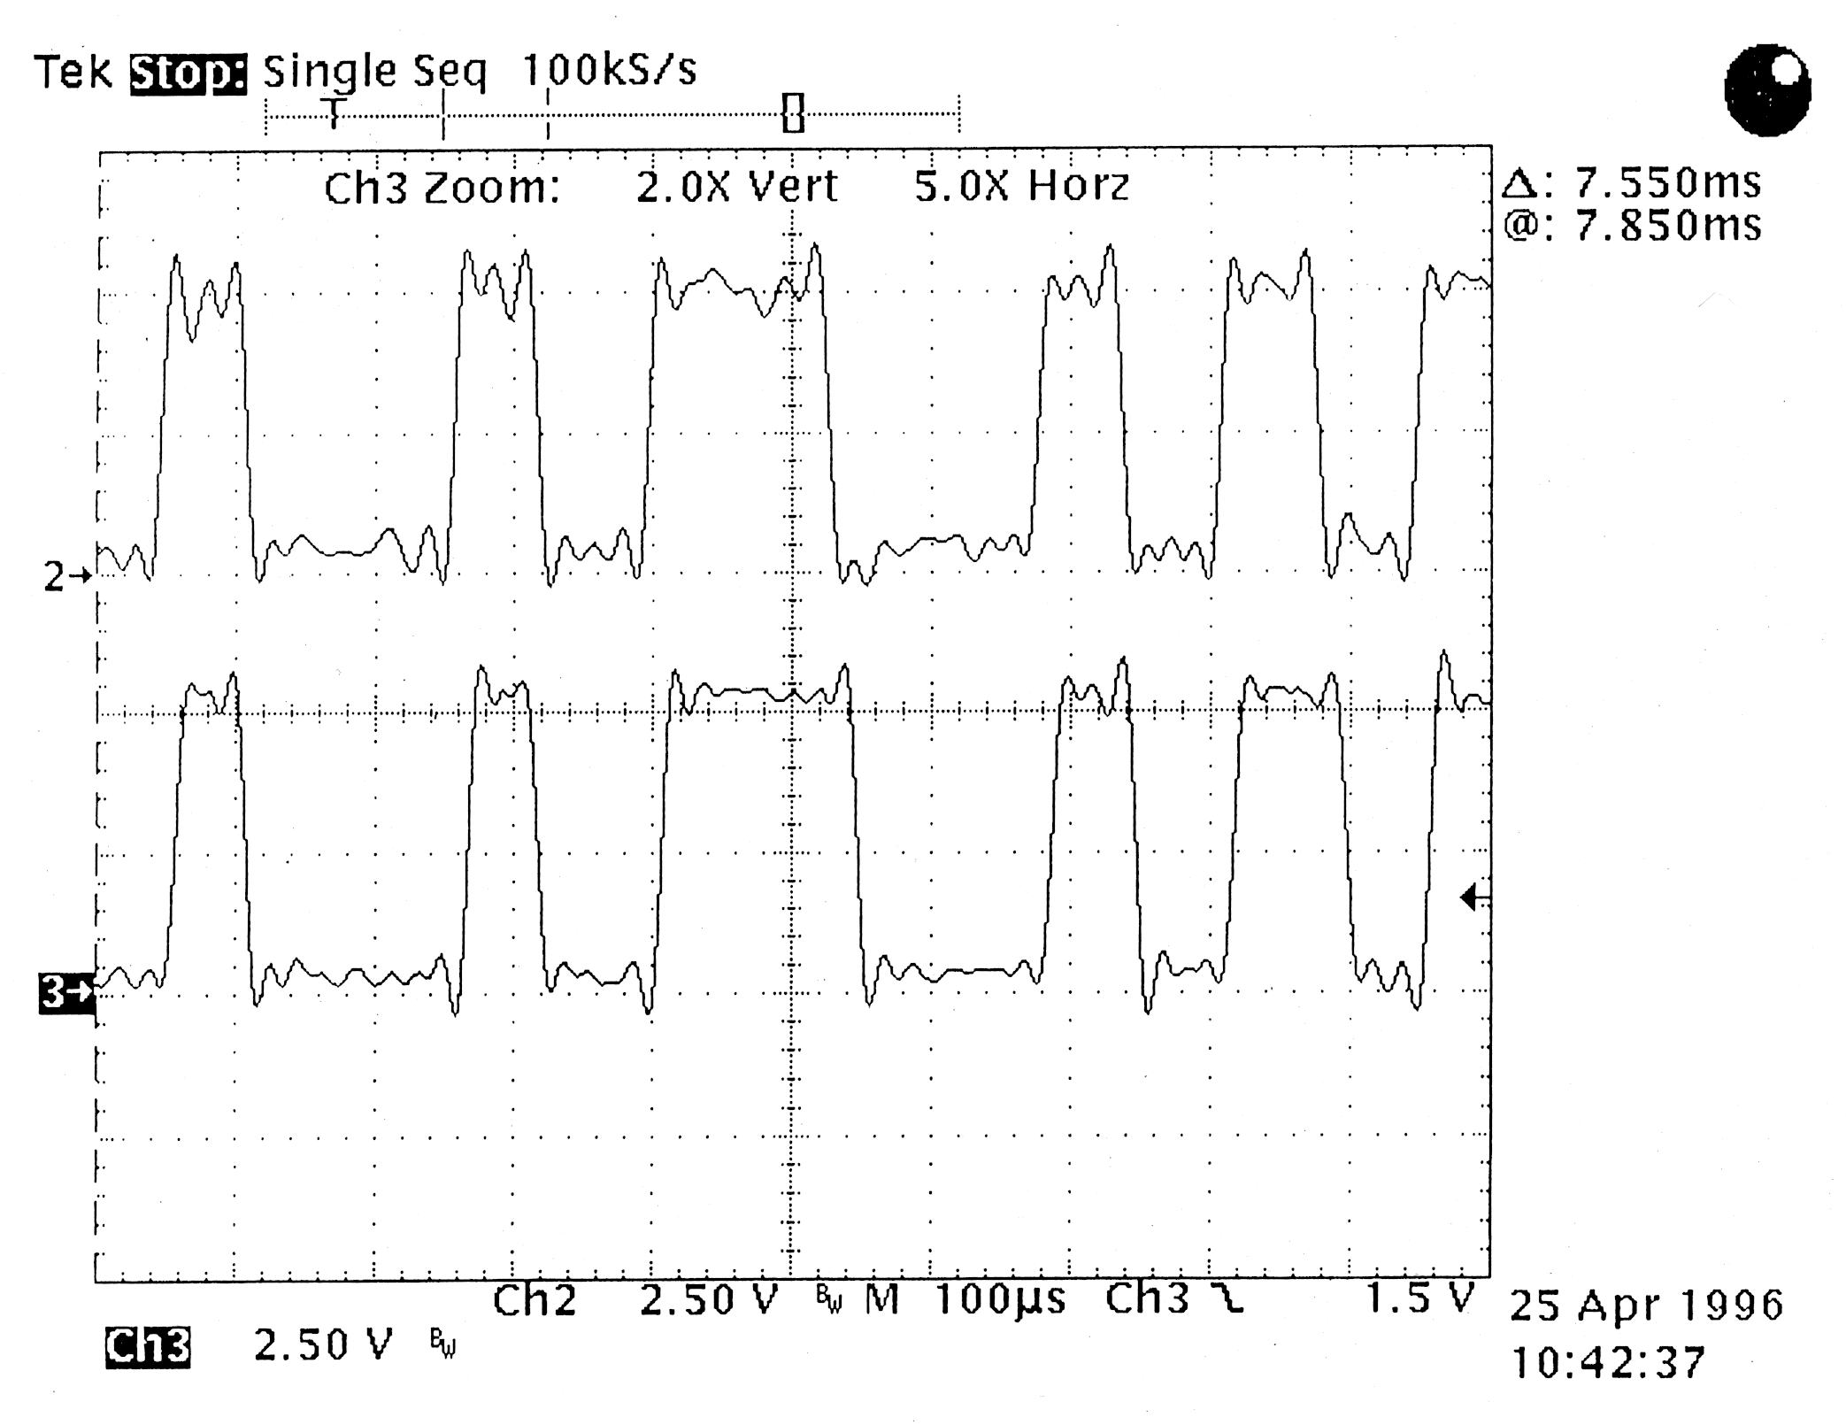
Oscilloscope Traces of Digital Signals with Noise Component

Slide 6
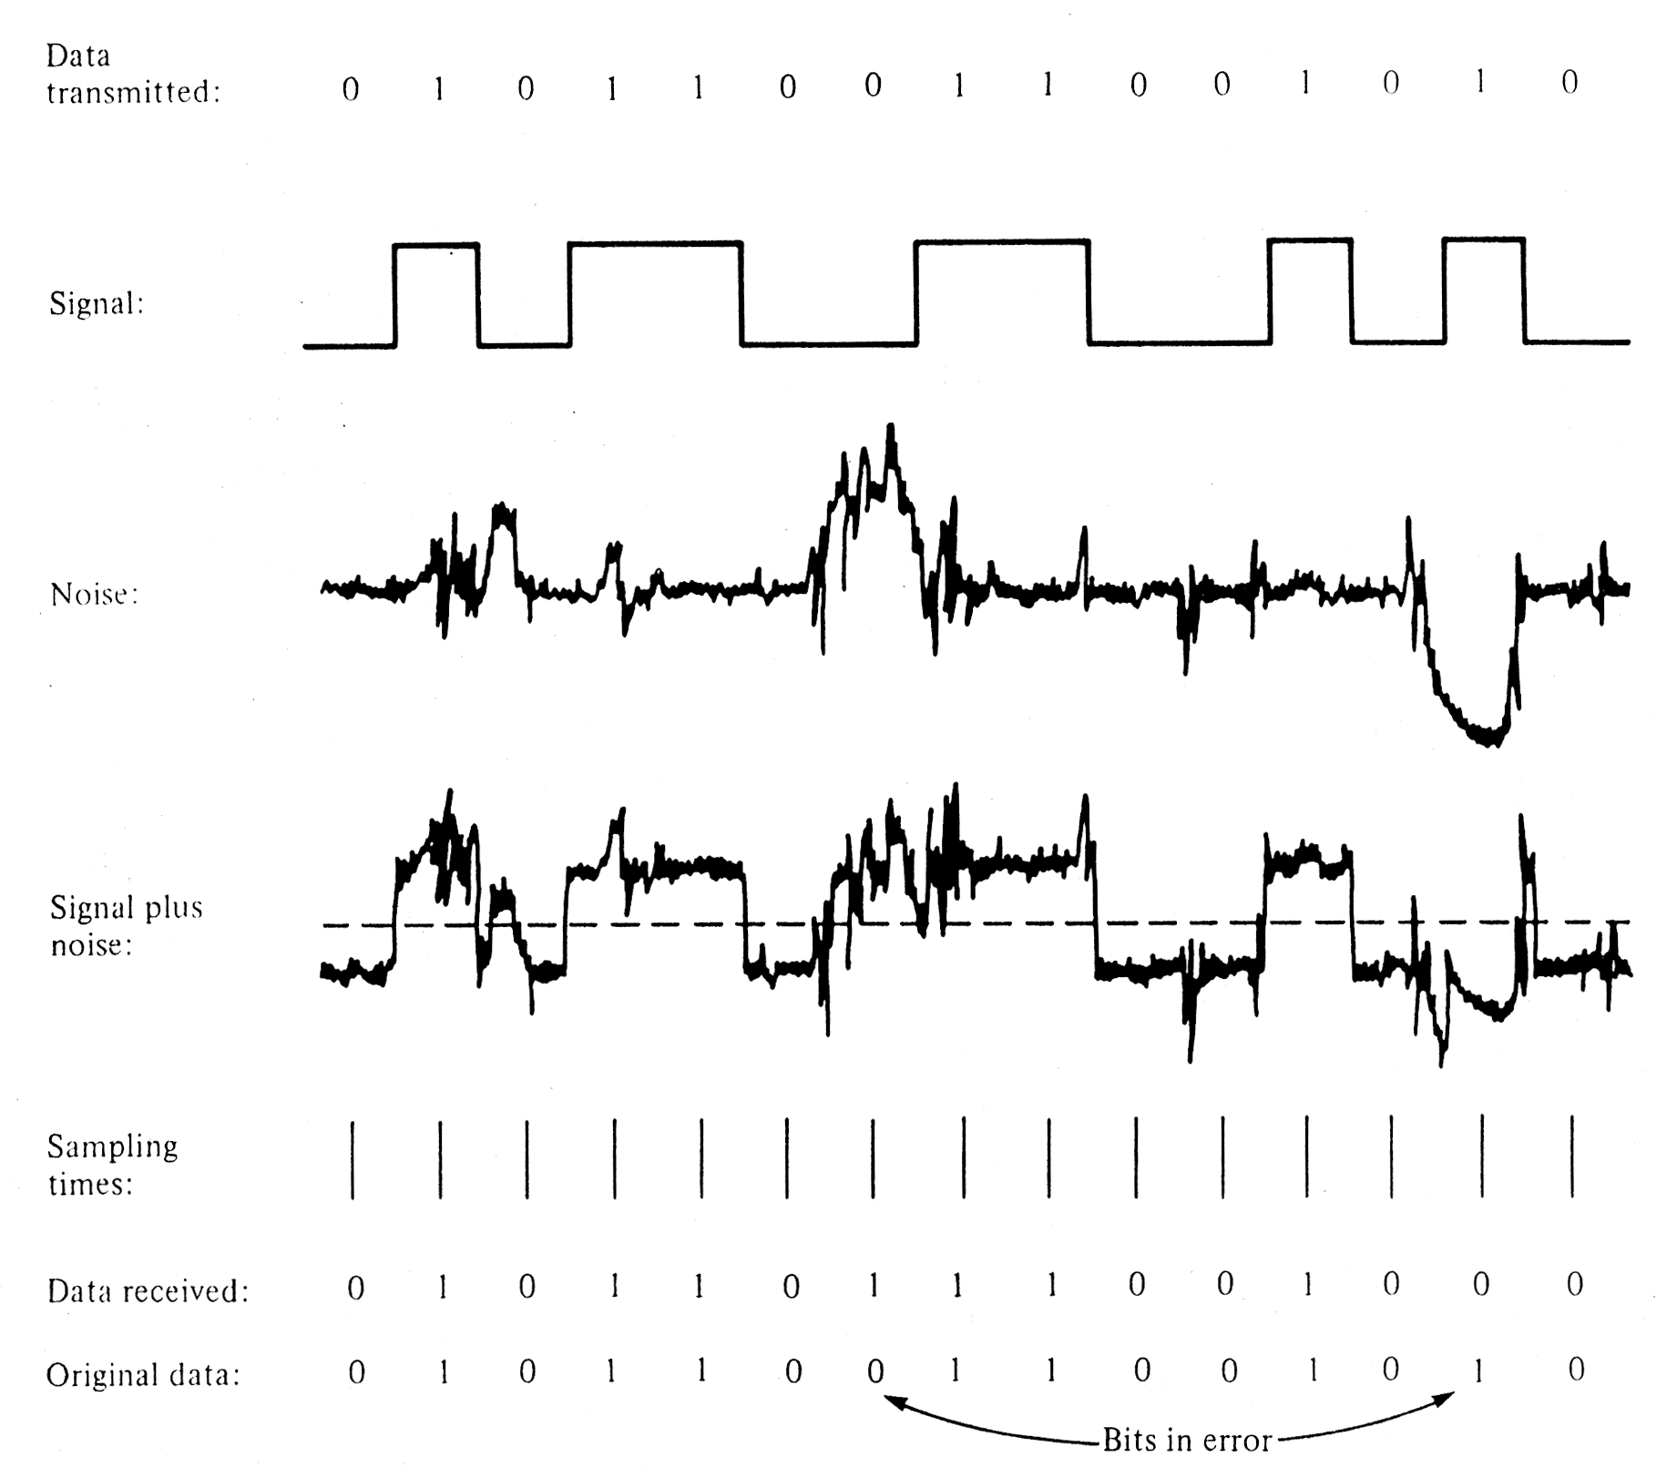
Effect of Noise on a Digital Signal
NRZ
From Data and Computer Communications, 4th Ed. by W. Stallings (Prentice Hall)

Slide 7
Factors that Influence Noise-Related Bit Errors
Distance from transmission medium to noise source, which affects…
Amplitude of the signal, relative to the amplitude of the noise
Called the signal-to-noise or “S/N” ratio
Expressed fractionally, or logarithmically in decibels (dB)
Type of signaling system used (level-sensitive sampling is often more susceptible than edge-triggered)
The type of noise (crosstalk/impulse/continuous)
The data rate (all else being equal, higher bps = more bit errors)

Slide 8
Significant Types of Electrical Noise
Crosstalk occurs when one channel or circuit “spills over” into another
Caused by leakage between different circuits in the same cable or overlapping of radio or TV channels
Fairly easy to predict and “design around”
Impulse noise consists of short, strong noise bursts or “spikes”
Caused by anything that generates an electrical spark or arc: lightning, starting heavy electrical equipment, auto ignitions, electric motors, arc welders, static discharges
Unpredictable
Not a big problem for analog voice networks (humans can sort it out) but a major problem for data transmission
Continuous broad-spectrum “white” noise is often present, but usually predictable. “Pink” and Gaussian noise are similar.
Impulse noise is the most significant noise problem in data communications, and most bit errors are caused by impulse noise (not by crosstalk, continuous or other types of noise)

Slide 9
Methods for Suppressing Noise
Use shielded cable
However, in LAN systems, you must use the type of cable specified by the standard
Noise sources can be detected, and be shielded or relocated
Media cables can be relocated away from noise sources
Use optical fiber (essentially immune to electrical noise)

Slide 10
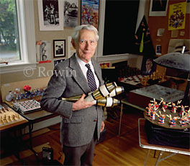
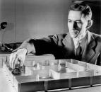
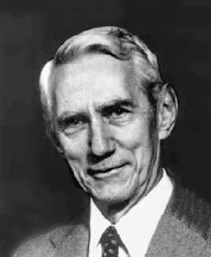
Claude Shannon (1916 - 2001) “The Father of Information Theory”
The inscription on the statue of Shannon at the University of Michigan says: “…His formulation of the mathematical theory of communication provided the foundation for the development of data storage and transmission systems that launched the information age.”

Slide 11
The Shannon-Hartley Theorem (continued on slide 12-13)
The Shannon-Hartley Theorem expresses the maximum theoretical data rate of a link, given a certain (analog) bandwidth and S/N ratio*
C = B log₂(1 + S/N)
C is channel capacity (error-free data rate in bps)
B is analog (true) bandwidth in Hz (as in 550MHz for CAT 6 UTP)
S/N is Signal-to-Noise ratio expressed as a fraction
For example, we can use Shannon-Hartley to predict the maximum data rate that a modem can transmit over a voice grade phone line (local loop)
A typical phone line has a frequency range (true analog bandwidth) of about 300 to 3300Hz, so B ≈ 3300Hz - 300Hz= 3000Hz
A typical signal to noise ratio for a "clean" voice grade line that has at least one analog-to-digital conversion is around 30dB
*Assumes the probability of an error is “arbitrarily small”. The noise is assumed to be continuous Gaussian noise.

Slide 12
Signal to Noise Ratio Samples
These audio samples will give you an idea of what a 20dB, 30dB and 40dB ratio sounds like to the human ear. Each sample alternates between a louder signal tone and a softer “noise” tone. Try it with your speakers or headphones set to a low volume level at first. You’ll need a quiet environment to hear the “noise” tone at 40dB.
20dB (100/1): http://www.bcae1.com/images/wavs/updn20db.wav
30dB (1000/1): http://www.bcae1.com/images/wavs/updn30db.wav
40dB (10,000/1): http://www.bcae1.com/images/wavs/updn40db.wav
http://www.bcae1.com/sig2nois.htm

Slide 13
The Shannon-Hartley Theorem (continued from slide 12-11)
Convert the S/N ratio from dB to a fraction as follows:
dB = 10 x log₁₀(S/N), which is equivalent to S/N = 10^{(dB/10)}
In this case (30dB), S/N = 10^{(30/10)} = 10³ = 1000
Thus, the fractional S/N ratio is 1000/1
Substituting the S/N ratio into the original formula, we get
C = 3000 x log₂(1 + 1000)
C = 3000 x 9.967 [2^{9.967} = 1001]
C = 29,900 bps
If your calculator has a common log (″log₁₀″ or ″log″) key,
you can calculate log₂ n = log₁₀ n = log₁₀ n
log₁₀ 2 0.301

Slide 14
Slide 14
The Third Principle of Network Design
“Packets are encapsulated within frames”
Layer 1 Layer 2 Layer 3 Layer 4

Slide 15
Problems Associated with Framing
Designing a frame format flexible enough to carry many types of data as a payload
Determining where (within the incoming signal) the frame begins and ends
Identifying where various sections within the frame begin and end
Determining if bit errors have occurred, and differentiating a real frame from noise on the circuit that “looks like” bits
Providing feedback to the sender about whether the frame was correctly received
Keeping the pipe filled with frames (to utilize the link as efficiently as possible)

Slide 16
Homework Question B.
B. Using the preceding Shannon-Hartley Theorem slides as a guide, calculate the theoretical data rate for a high-quality local loop (residential phone circuit) that has a bandwidth of 50 to 3500 Hz, and a S/N ratio of 39dB. (10 points)

